Slide 1
ADTA 5230 and IPAC 4230 Section 501, Data Analytics II
Module 7:
Chapter 15: Cluster Analysis

Slide 2
Outline
- Introduction/Basics
- Types of Cluster Analysis
- Visualization with Dendrogram
- Hierarchical Clustering
- The k-Means Algorithm

Slide 3
Clustering: Basics
- Part of unsupervised learning
- Goal is to segment the data into a set of homogeneous clusters of records
- Cluster analysis is used to form groups or clusters of similar records based on several measurements made on these records.
- The key idea is to characterize the clusters in ways that would be useful for the aims of the analysis.
- Example: Used for segmenting markets into groups of similar customers
- Python Libraries:
- numpy for handling
- scikit-learn and scipy for cluster analysis
- matplotlib for visualization

Slide 4
Other Applications
- Periodic table of the elements
- Classification of species
- Grouping securities in portfolios
- Grouping firms for structural analysis of economy
- Army uniform sizes
- Segments of voters

Slide 5
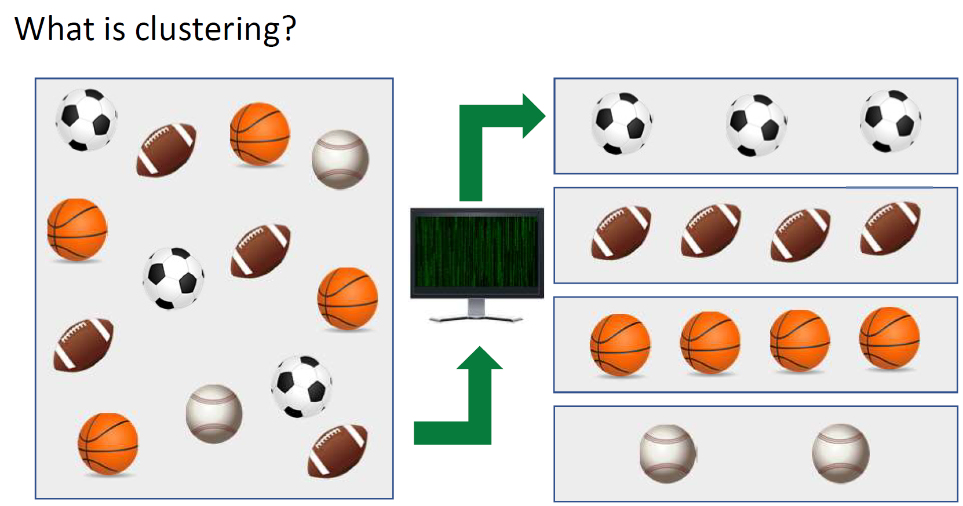
Clustering

Slide 6
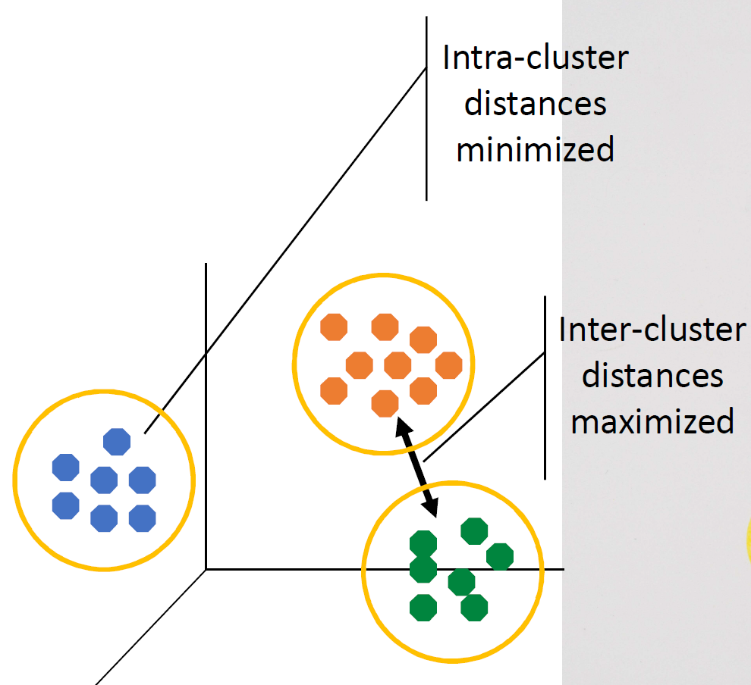
What is Clustering?
• Organizing data into classes such that there is:
• high intra-class similarity
• low inter-class similarity
• Finding the class labels and number of classes directly from the data.
• More informally, finding natural groupings among objects.

Slide 7
What is Clustering?
• Clustering is not the same but similar to classification
• Clustering is used for unsupervised learning & unlabeled data
• Clustering identifies similarities between objects, which it groups according to those characteristics in common and which differentiate them from other
Remember:
• Classification is used for supervised learning & labeled data
• Classification uses predefined labels or classes in which objects are assigned

Slide 8
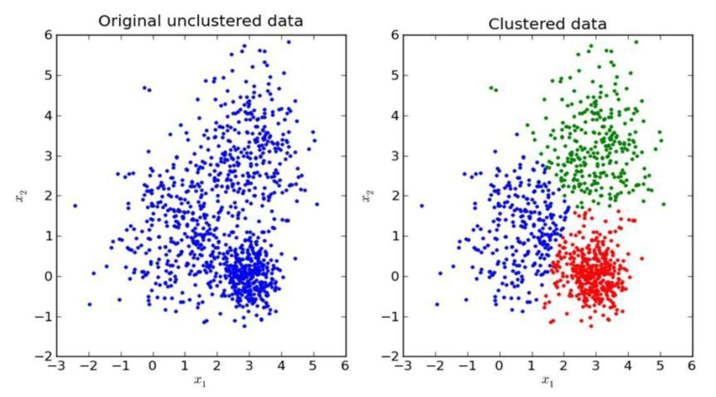
Process of Partitioning

Slide 9
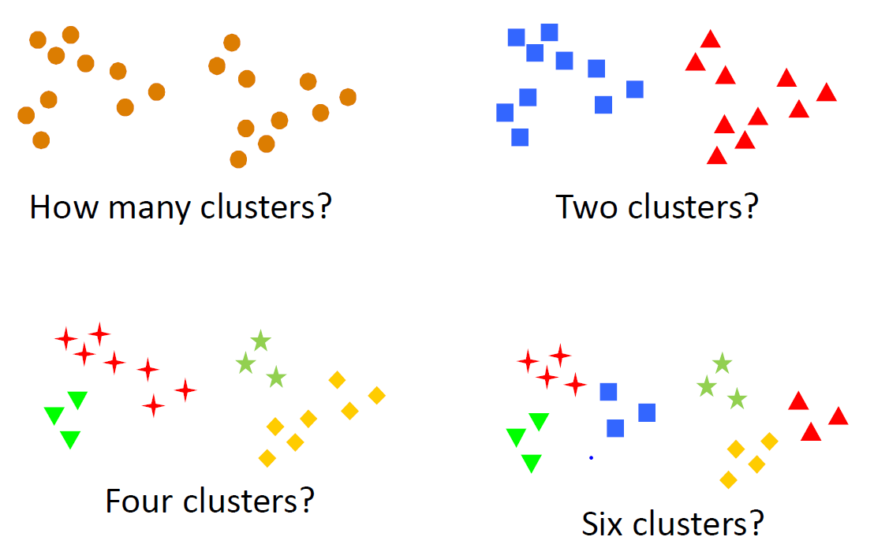
How Many Clusters?
Subjective Judgement

Slide 10
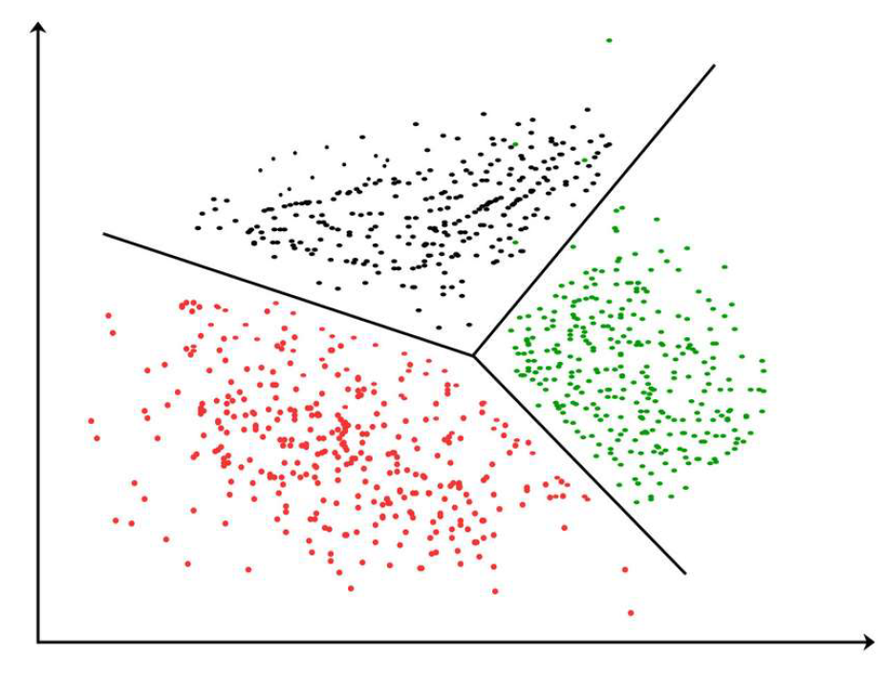
Clustering
Partitioning a dataset into smaller groups of data

Slide 11
Illustrative Example: Public Utilities
Goal: find clusters of similar utilities
Data: 22 firms, 8 variables
Fixed = fixed-charge covering ratio (income/debt);
RoR = rate of return on capital
Cost = cost per kilowatt capacity in place;
Load = annual load factor
Demand = peak kilowatthour demand growth from 1974 to 1975
Sales = sales (kilowatthour use per year)
Nuclear = percent nuclear
Fuel Cost = total fuel costs (cents per kilowatthour)

Slide 12
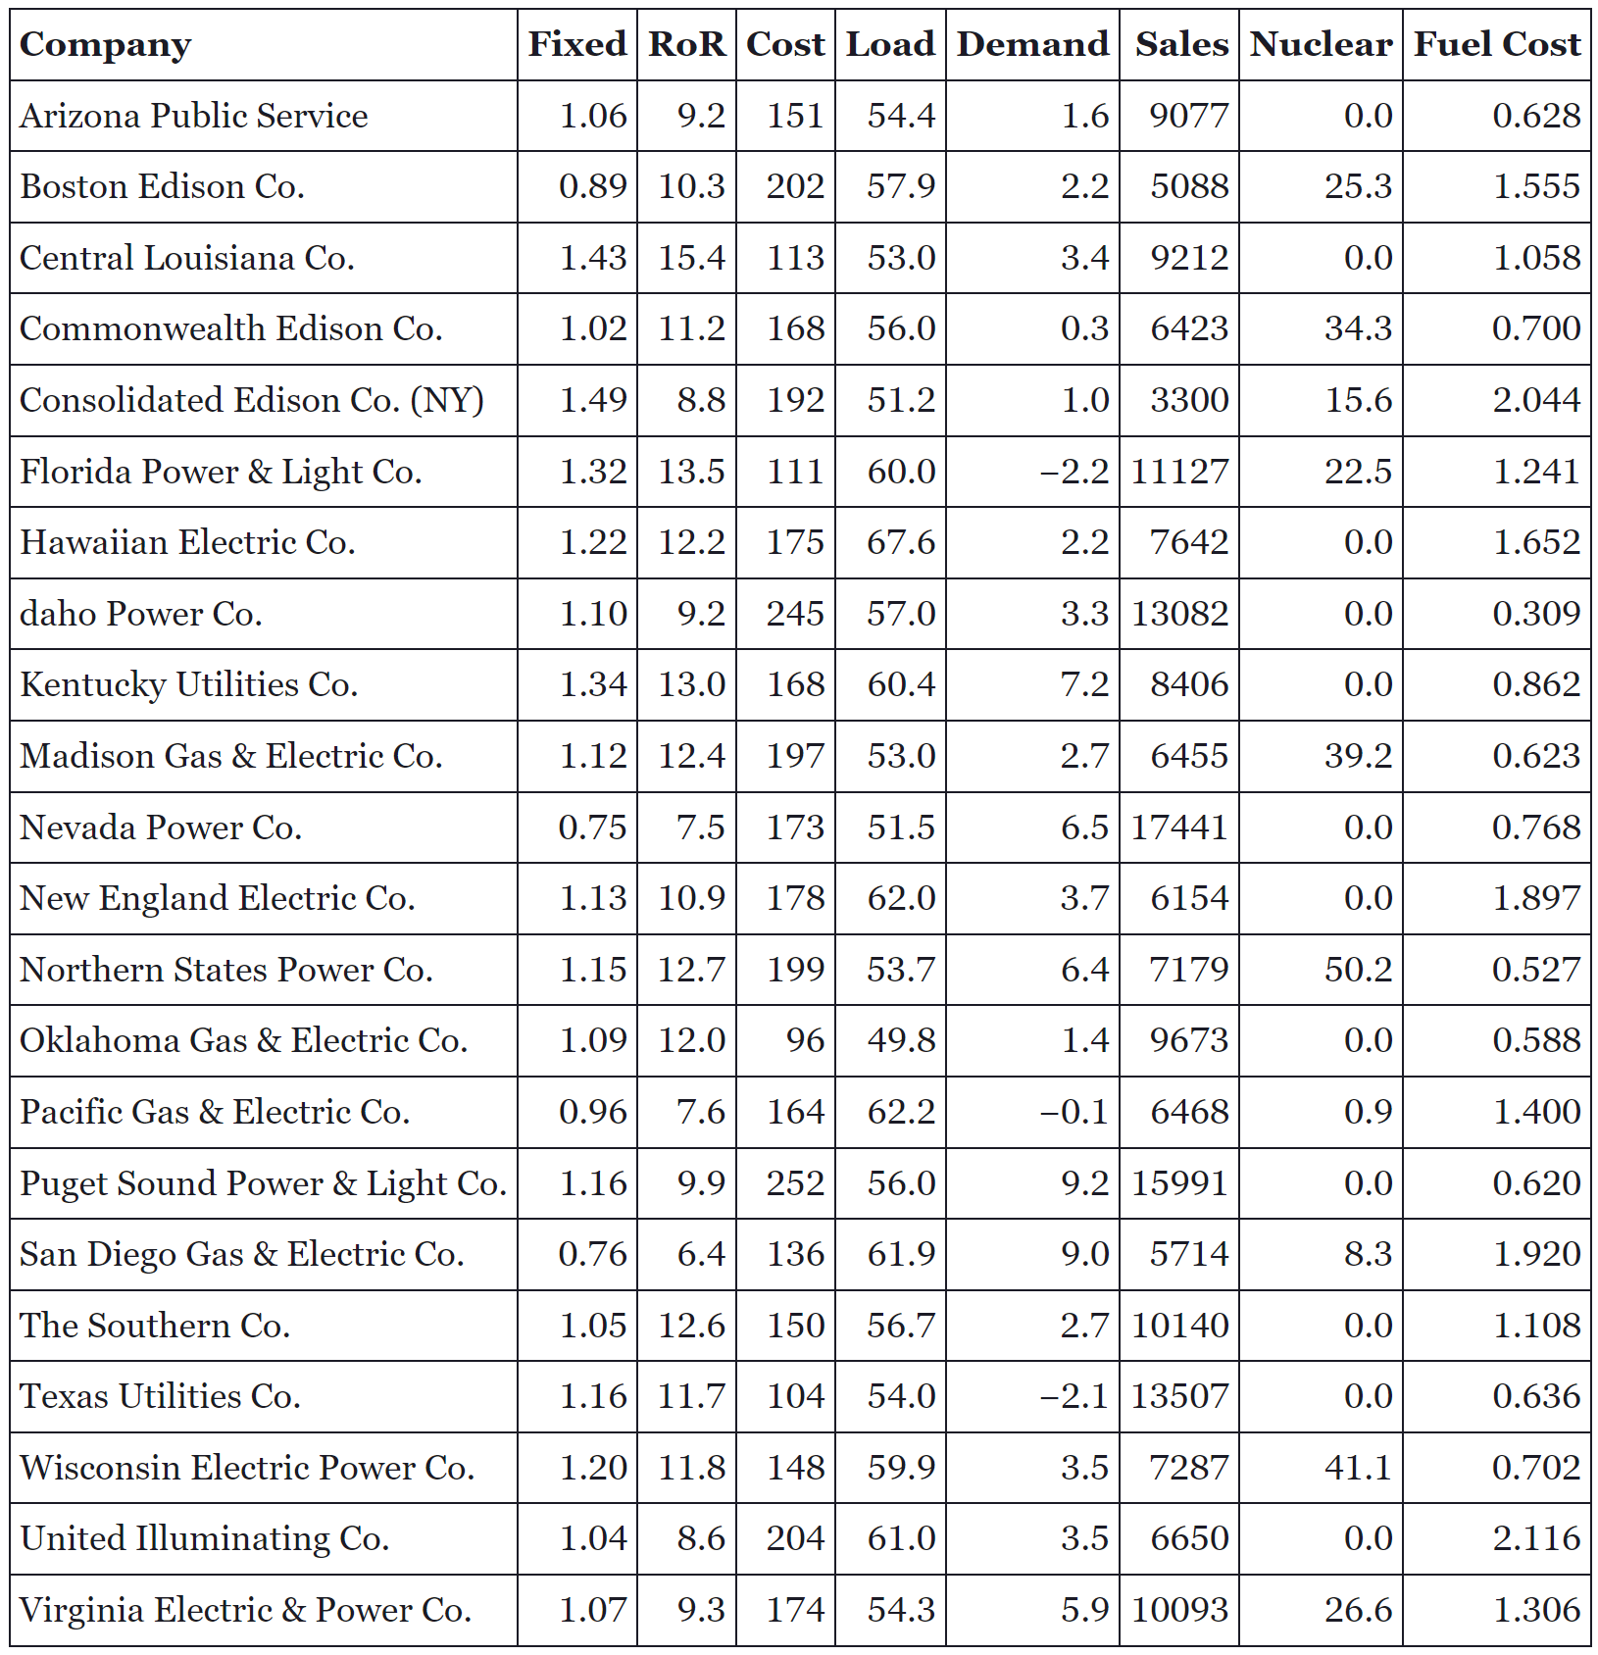
Example: Public Utilities

Slide 13
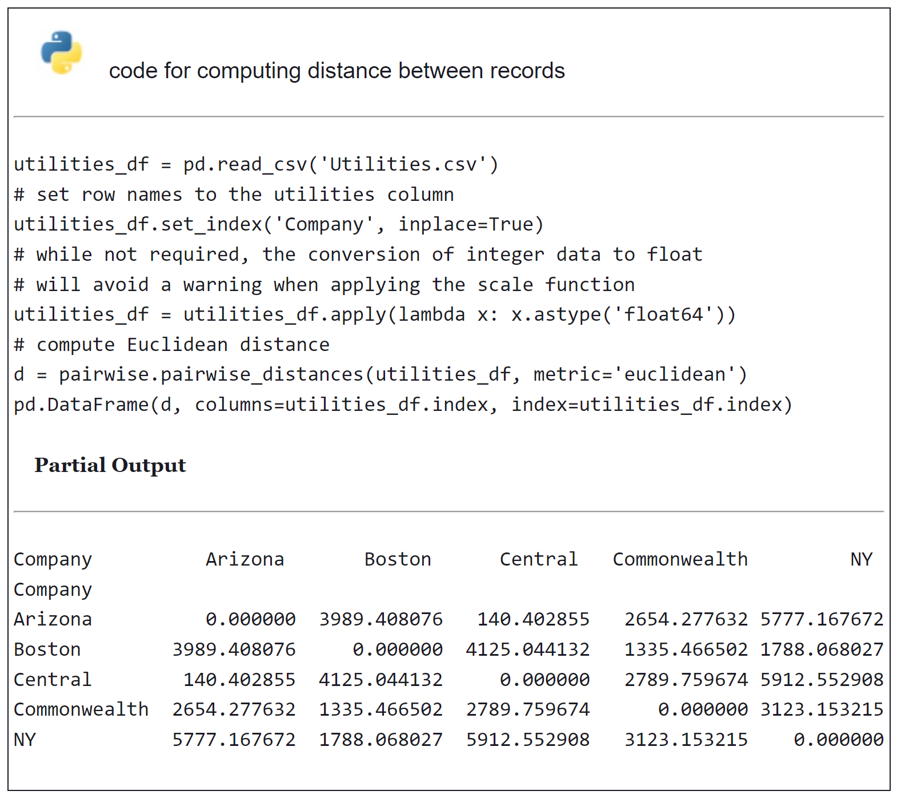
Example: Public Utilities

Slide 14
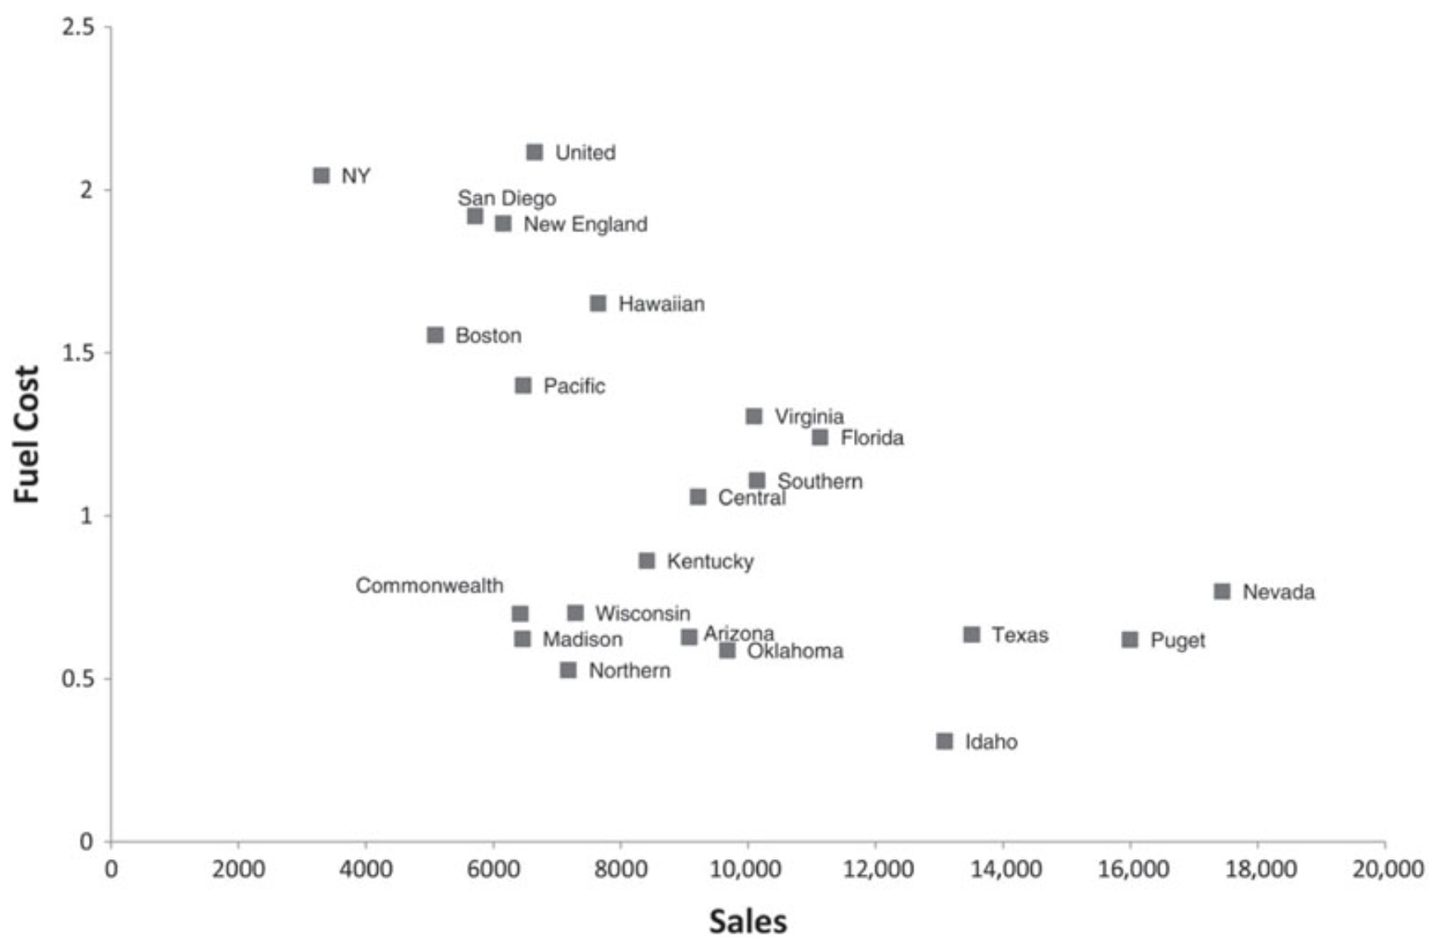
Example: Public Utilities

Slide 15
Other Applications
Two general types of clustering algorithms for a dataset of n records are hierarchical and non-hierarchical clustering:
Hierarchical methods: can be either agglomerative or divisive. Agglomerative methods begin with n clusters and sequentially merge similar clusters until a single cluster is obtained. Divisive methods work in the opposite direction, starting with one cluster that includes all records. Hierarchical methods are especially useful when the goal is to arrange the clusters into a natural hierarchy.
Non-hierarchical methods: such as k-means. Using a prespecified number of clusters, the method assigns records to each cluster. These methods are generally less computationally intensive and are therefore preferred with very large datasets.

Slide 16
Extension to More Than 2 Dimensions
In prior example, clustering was done by eye
Multiple dimensions require formal algorithm with
- A distance measure
- A way to use the distance measure in forming clusters
We will consider two algorithms: hierarchical and non-hierarchical

Slide 17
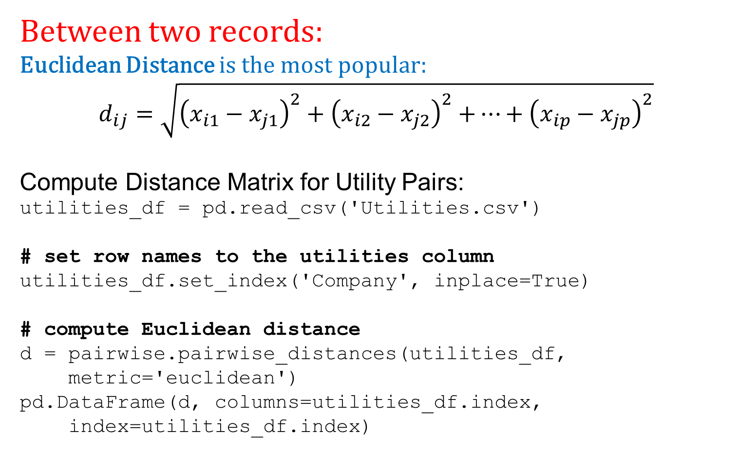
Measuring Distance
Between two records:
Euclidean Distance is the most popular:
$$d_{ij}=\sqrt{{\left(x_{i1}−x_{j1}\right)}^{2}+{\left(x_{i2}−x_{j2}\right)}^{2}{+…+\left(x_{ip}−x_{jp}\right)}^{2}}$$
Compute Distance Matrix for Utility Pairs:
utilities_df = pd.read_csv('Utilities.csv')
# set row names to the utilities column
utilities_df.set_index('Company', inplace=True)
# compute Euclidean distance
d = pairwise.pairwise_distances(utilities_df,
metric='euclidean')
pd.DataFrame(d, columns=utilities_df.index,
index=utilities_df.index)

Slide 18
Output: Distance Matrix for Utility Pairs
Partial Output
Company Arizona Boston Central Commonwealth NY
Arizona 0.000000 3989.408076 140.402855 2654.277632 5777.167672
Boston 3989.408076 0.000000 4125.044132 1335.466502 1788.068027
Central 140.402855 4125.044132 0.000000 2789.759674 5912.552908
Commonwealth 2654.277632 1335.466502 2789.759674 0.000000 3123.153215
NY 5777.167672 1788.068027 5912.552908 3123.153215 0.000000

Slide 19
Normalizing
Problem: Raw distance measures are highly influenced by scale of measurements
Solution: normalize (standardize) the data first
- Subtract mean, divide by std. deviation
- Also called z-scores
Or Rescale to 0/1 range
- Subtract the minimum
- Divide by range

Slide 20
Example: Normalization
For 22 utilities:
Avg. sales = 8,914
Std. dev. = 3,550
Normalized score for Arizona sales:
(9,077 - 8,914)/3,550 = 0.046

Slide 21
Code for Normalizing then Computing Distance
# using scikit-learn*
utilities_df_norm = utilities_df.apply(preprocessing.scale,
axis=0)
# using pandas*
utilities_df_norm = (utilities_df -
utilities_df.mean())/utilities_df.std()
# compute normalized distance based on Sales and Fuel Cost
utilities_df_norm[['Sales', 'Fuel_Cost']]
d_norm = pairwise.pairwise_distances
(utilities_df_norm[['Sales', 'Fuel_Cost']],
metric='euclidean')
pd.DataFrame(d_norm, columns=utilities_df.index,
index=utilities_df.index)
*scikit-learn uses population std. dev. (divide by n), pandas uses sample std. dev. (divide by n-1)

Slide 22
Distance Matrix - Normalized
Partial output
Company Arizona Boston Central Commonwealth NY
Company
Arizona 0.000000 2.010329 0.774179 0.758738 3.021907
Boston 2.010329 0.000000 1.465703 1.582821 1.013370
Central 0.774179 1.465703 0.000000 1.015710 2.432528
Commonwealth 0.758738 1.582821 1.015710 0.000000 2.571969
NY 3.021907 1.013370 2.432528 2.571969 0.000000

Slide 23
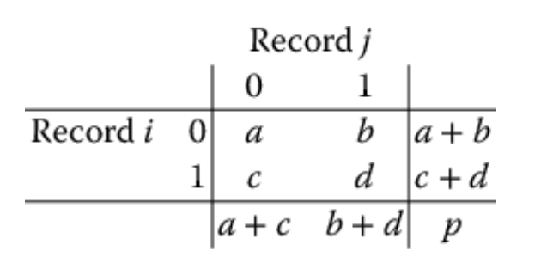
For Categorical Data: Similarity
To measure the distance between records in terms of two 0/1 variables, create table with counts:
a denotes the number of variables for which records i and j do not have that attribute (they each have value 0 on that attribute), d is the number of variables for which the two records have the attribute present, and so on.
Similarity metrics based on this table:
- Matching coef. = (a+d)/p
- Jaquard’s coef. = d/(b+c+d)
- Use in cases where a matching “1” is much greater evidence of similarity than matching “0” (e.g. “owns Corvette”)

Slide 24
Other Distance Measures
- Correlation-based similarity
- Statistical distance (Mahalanobis)
- Manhattan distance (absolute differences)
- Maximum coordinate distance

Slide 25
Measuring Distance Between Clusters A and B
Minimum Distance: (single linkage)
- Distance between two clusters is the distance between the pair of records A_{i} and B_{j} that are closest
Maximum Distance: (complete linkage)
- Distance between two clusters is the distance between the pair of records A_{i} and B_{j} that are farthest from each other
Average Distance: (average linkage)
- Distance between two clusters is the average of all possible pair-wise distances
Centroid Distance:
- Distance between two clusters is the distance between the two cluster centroids.
- Centroid is the vector of variable averages for all records in a cluster

Slide 26
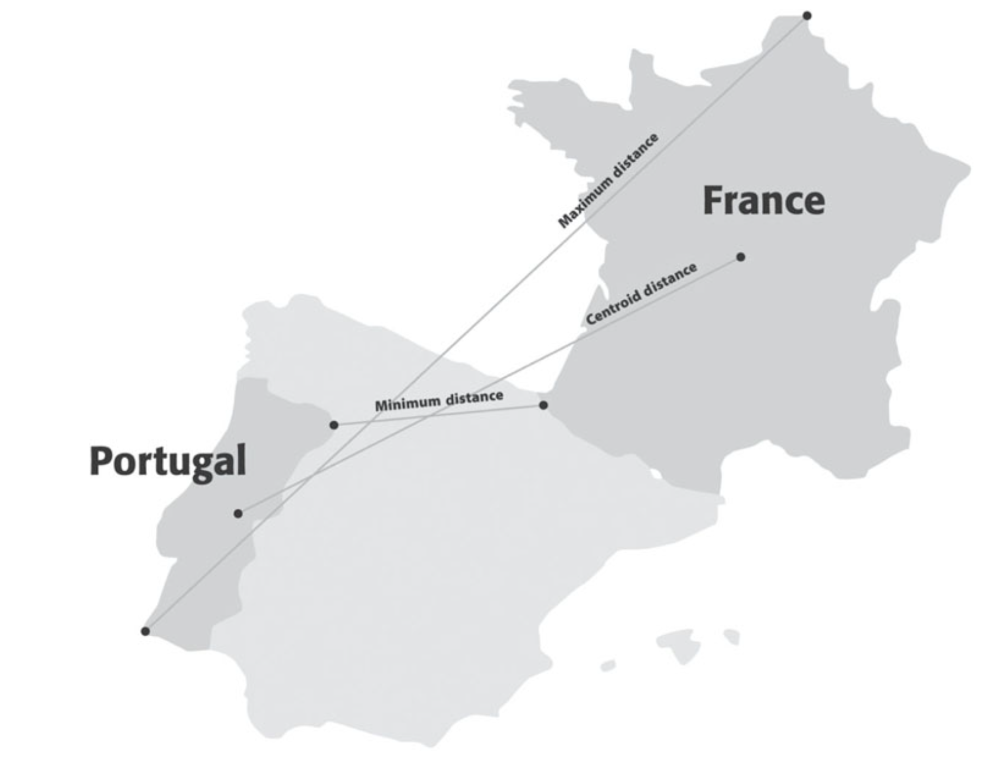
Measuring Distance Between Clusters A and B

Slide 27
Hierarchical Methods
Agglomerative Methods
- Begin with n-clusters (each record its own cluster)
- Keep joining records into clusters until one cluster is left (the entire data set)
- Most popular
Divisive Methods
- Start with one all-inclusive cluster
- Repeatedly divide into smaller clusters

Slide 28
Hierarchical Clustering
The Hierarchical Clustering Steps (Using Agglomerative Method)
Start with n clusters (each record is its own cluster)
Merge two closest records into one cluster
At each successive step, the two clusters closest to each other are merged
Dendrogram, from bottom up, illustrates the process

Slide 29
Code for Hierarchical Clustering
Plotting the Dendrogram: Single and Average Linkage
# in linkage() set argument method =
# 'single', 'complete', 'average', 'weighted', centroid', # 'median', 'ward'
Z = linkage(utilities_df_norm, method='single')
dendrogram(Z, labels=utilities_df_norm.index, color_threshold=2.75)
Z = linkage(utilities_df_norm, method='average')
dendrogram(Z, labels=utilities_df_norm.index, color_threshold=3.6)

Slide 30
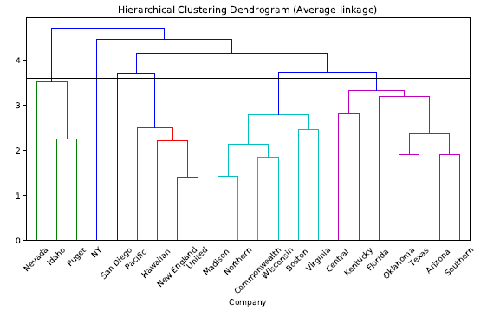
Dendrogram for Average Linkage
How many clusters are the here?

Slide 31
Reading the Dendrogram
See process of clustering: Lines connected lower down are merged earlier
- New England and United will be merged first, then Madison and Northern
Determining number of clusters: For a given “distance between clusters”, a horizontal line intersects the clusters that are that far apart, to create clusters
- At distance of 3.6 (horizontal line in the slide) data can be reduced to 6 clusters – 2 singletons, and 4 clusters

Slide 32
Finding Cluster Membership
Average Linkage (output modified for clarity)
> memb = fcluster(linkage(utilities_df_norm,
method='average'), 6, criterion='maxclust')
> memb = pd.Series(memb, index=utilities_df_norm.index)
> for key, item in memb.groupby(memb):
> print(key, ': ', ', '.join(item.index))
1 : Idaho, Nevada, Puget
2 : Hawaiian, New England, Pacific, United
3 : San Diego
4 : Boston, Commonwealth, Madison, Northern, Wisconsin, Virginia
5 : Arizona, Central, Florida, Kentucky, Oklahoma, Southern, Texas
6 : NY

Slide 33
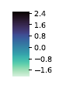
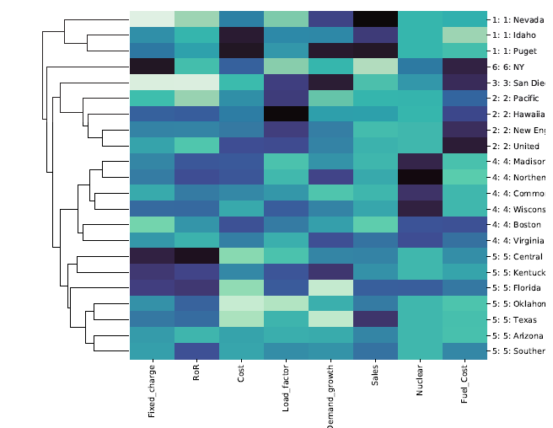
Visualize Cluster Features with Heatmap
darker = higher values

Slide 34
Nonhierarchical Clustering: K-Means Clustering
Average Linkage (output modified for clarity)
> memb = fcluster(linkage(utilities_df_norm,
method='average'), 6, criterion='maxclust')
> memb = pd.Series(memb, index=utilities_df_norm.index)
> for key, item in memb.groupby(memb):
> print(key, ': ', ', '.join(item.index))
1 : Idaho, Nevada, Puget
2 : Hawaiian, New England, Pacific, United
3 : San Diego
4 : Boston, Commonwealth, Madison, Northern, Wisconsin, Virginia
5 : Arizona, Central, Florida, Kentucky, Oklahoma, Southern, Texas
6 : NY

Slide 35
Centralized or Centroid-based Clustering
• Formed by the closeness of data points to the centroid of clusters
• The cluster center (centroid) is formed such that the distance of the data points is minimum with the center
• The biggest problem with this algorithm is that we need to specify K in advance
How many clusters are there?

Slide 36
K-Means Clustering Algorithm
Choose # of clusters desired, k
Start with a partition into k clusters
Often based on random selection of k centroids
At each step, move each record to cluster with closest centroid
Recompute centroids, repeat step 3
Stop when moving records increases within-cluster dispersion

Slide 37
K-Means Steps
1. Select the desired number of clusters, k
2. Select k initial observations as centroids
3. Assign observations to the cluster with the nearest centroid
4. Recalculate cluster centroids based on the new assignments from step 3
5. Repeat steps 3 and 4 and stop when there are no more new assignments
Watch the animations:
https://www.youtube.com/watch?v=5I3Ei69I40s&t=34s
https://www.youtube.com/shorts/Rt8GQ6kLeSQ
k=6

Slide 38
K-means Algorithm: Choosing k and Initial Partitioning
Choose k based on the how results will be used
e.g., “How many market segments do we want?”
Also experiment with slightly different k’s
Initial partition into clusters can be random, or based on domain knowledge
If random partition, repeat the process with different random partitions

Slide 39
Code for K-means Clustering
# Load and preprocess data
utilities_df = pd.read_csv('Utilities.csv')
utilities_df.set_index('Company', inplace=True)
utilities_df = utilities_df.apply(lambda x: x.astype('float64'))
# Normalize distances
utilities_df_norm = utilities_df.apply(preprocessing.scale, axis=0)
kmeans = KMeans(n_clusters=6,
random_state=0).fit(utilities_df_norm)
ask for 6 clusters

Slide 40
Output: K-means Clustering
# Cluster membership
memb = pd.Series(kmeans.labels_, index=utilities_df_norm.index)
for key, item in memb.groupby(memb):
print(key, ': ', ', '.join(item.index))
Output
0 : Commonwealth, Madison , Northern, Wisconsin, Virginia
1 : Boston , Hawaiian , New England, Pacific , San Diego, United
2 : Arizona , Central , Florida , Kentucky, Oklahoma, Southern, Texas
3 : NY
4 : Nevada
5 : Idaho, Puget

Slide 41
Output: K-means Clustering: Cluster Centroids
> centroids = pd.DataFrame(kmeans.cluster_centers_,
columns=utilities_df_norm.columns)
> pd.set_option('precision', 3)
> centroids
Fixed_charge RoR Cost Load_factor Demand_growth Sales Nuclear Fuel_Cost
0 -0.012 0.339 0.224 -0.366 0.170 -0.411 1.602 -0.609
1 -0.633 -0.640 0.207 1.175 0.058 -0.758 -0.381 1.204
2 0.516 0.798 -1.009 -0.345 -0.501 0.360 -0.536 -0.420
3 2.085 -0.883 0.592 -1.325 -0.736 -1.619 0.219 1.732
4 -2.020 -1.476 0.120 -1.257 1.070 2.458 -0.731 -0.616
5 0.088 -0.541 1.996 -0.110 0.988 1.621 -0.731 -1.175

Slide 42
How Tight are the Clusters
# distances of each record to the cluster centers
distances = kmeans.transform(utilities_df_norm)
# find closest cluster for each record
minSquaredDistances = distances.min(axis=1) ** 2
# combine with cluster labels into a data frame
df = pd.DataFrame({'squaredDistance': minSquaredDistances,
'cluster': kmeans.labels_}, index=utilities_df_norm.index)
# group by cluster and print information
for cluster, data in df.groupby('cluster'):
count = len(data)
withinClustSS = data.squaredDistance.sum()
print(f'Cluster {cluster} ({count} members):
{withinClustSS:.2f} within cluster ')
Output
Cluster 0 (5 members): 10.66 within cluster
Cluster 1 (6 members): 22.20 within cluster
Cluster 2 (7 members): 27.77 within cluster
Cluster 3 (1 members): 0.00 within cluster
Cluster 4 (1 members): 0.00 within cluster
Cluster 5 (2 members): 2.54 within cluster

Slide 43
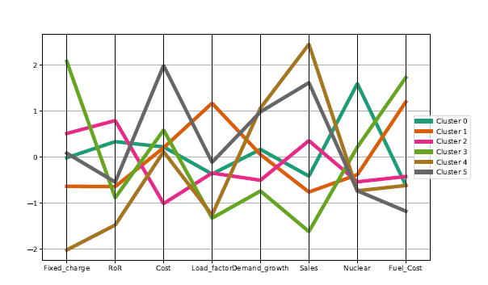
Profile Plot: K-means Clustering
centroids['cluster'] = ['Cluster {}'.format(i) for i in
centroids.index]
plt.figure(figsize=(10,6))
parallel_coordinates(centroids, class_column='cluster',
colormap='Dark2', linewidth=5)
plt.legend(loc='center left', bbox_to_anchor=(1, 0.5))

Slide 44
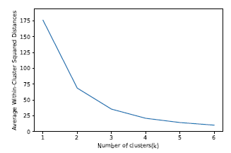
Different Choices for K
As the number of clusters increases, the cluster members are closer to one another.

Slide 45
Desirable Cluster Features
Stability – are clusters and cluster assignments sensitive to slight changes in inputs? Are cluster assignments in partition B similar to partition A?
Separation – check ratio of between-cluster variation to within-cluster variation (higher is better)

Slide 46
Summary
- Cluster analysis is an exploratory tool. Useful only when it produces meaningful clusters
- Hierarchical clustering gives visual representation of different levels of clustering
- On other hand, due to non-iterative nature, it can be unstable, can vary highly depending on settings, and is computationally expensive
- Non-hierarchical is computationally cheap and more stable; requires user to set k
- Can use both methods

